Slide 1
Simulink Model of ANTI LOCK BRAKING SYSTEM
Kurma Eshwar Sai Srinivas – 181ME141(Project Mentor)
Patrike Vedika Rajkumar- 191ME256
Diksha Negi-191ME129

Slide 2
ABS
• ABS prevents locking of wheels during braking
• During severe braking or on slippery surfaces, wheels approach lockup. At that time, ABS takes over
• ABS modulates the brake line pressure independent of the pedal force, to bring the wheel speed back to the slip level range that is necessary for optimal braking performance
Note: In this Model the ABS doesn’t work with speeds < 0.5 m/s

Slide 3
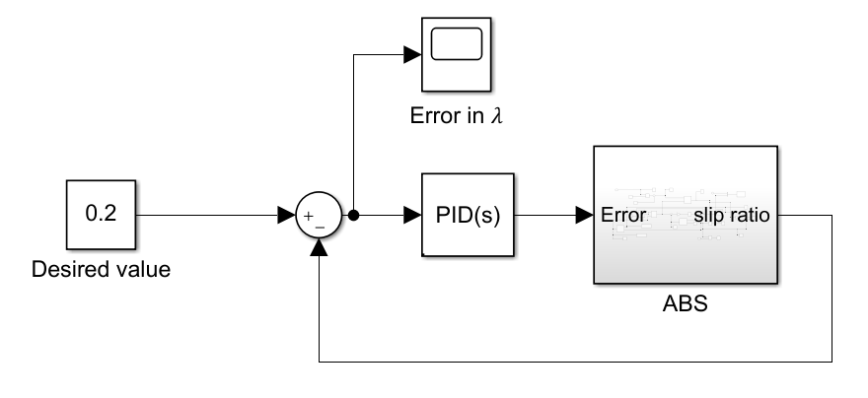
ABS Simulink MODEL
of slip (𝜆)

Slide 4
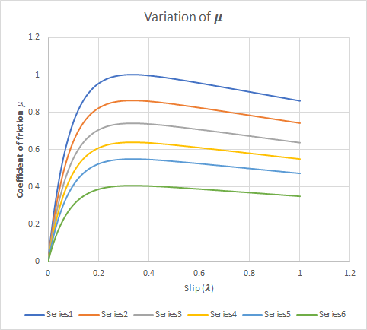

Why Desired Value of slip (𝜆) = 0.2?
For most of the surfaces optimum value of friction of coefficient is obtained for 0.2
Vx = 35 ms⁻¹
Vx = 25 ms⁻¹
Vx = 20 ms⁻¹
Vx = 15 ms⁻¹
Vx = 10 ms⁻¹
Vx = 5 ms⁻¹
Notes:
Explain with the figure during the project review

Slide 5
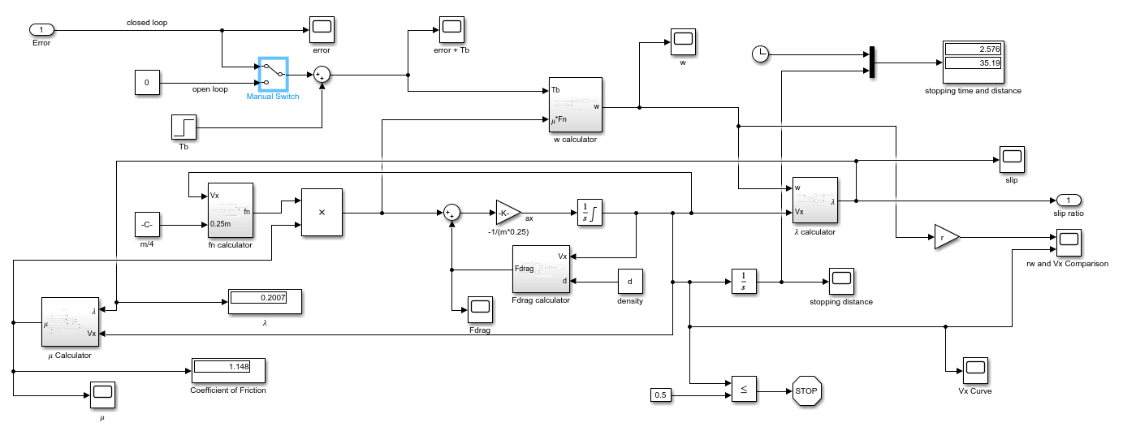
ABS Subsystem

Slide 6
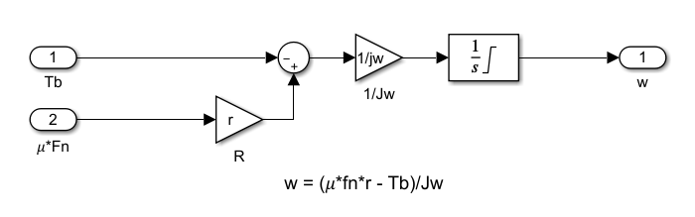
Angular Velocity (ω) Calculator

Slide 7
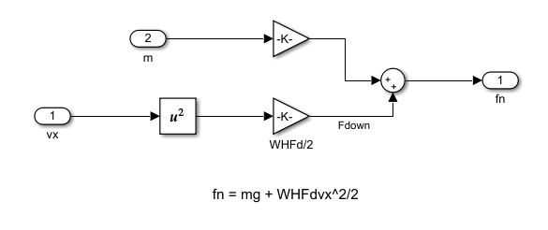
Normal force (F_{n} ) Calculator

Slide 8
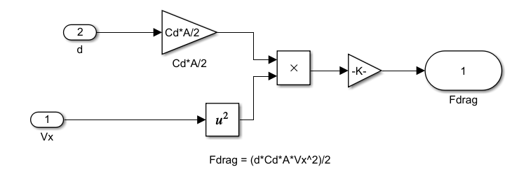
Drag Force (F_{drag} ) Calculator

Slide 9
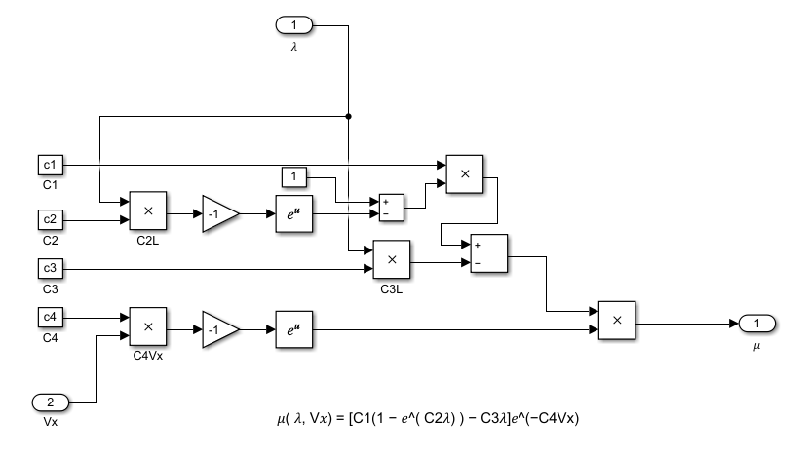
Coefficient of friction (𝜇) Calculator

Slide 10
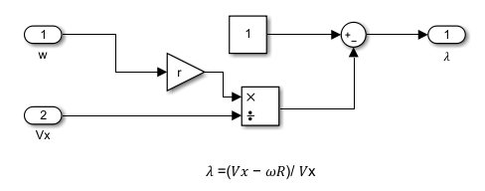
Slip (𝜆) calculator

Slide 11
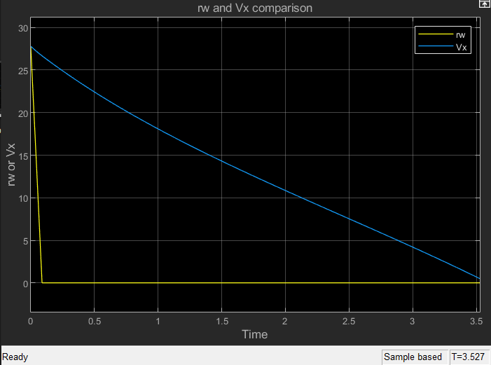
Open Loop Results: Velocity v/s time
Vehicle Longitudinal Velocity (Vx)
Wheel Peripheral Velocity (rω)
Wheel Starts Skidding From here

Slide 12
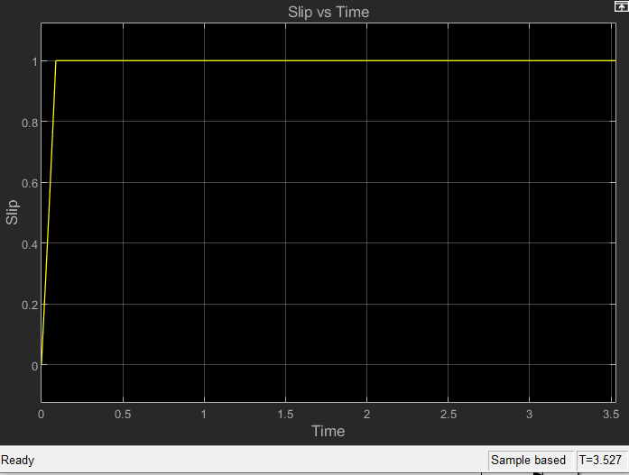
Open Loop Results: Slip v/s time
𝜆 = 1 when the wheel peripheral velocity is zero
Wheel Starts Skidding From here

Slide 13
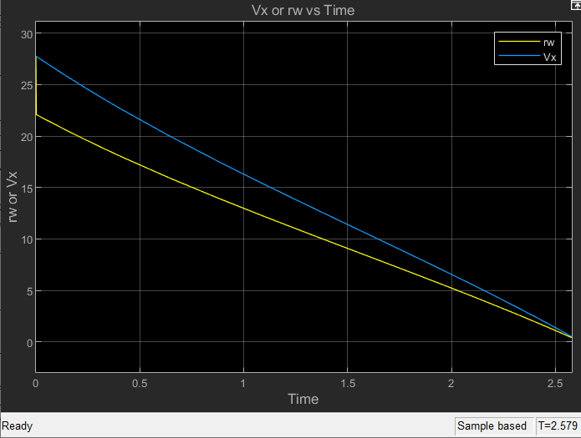
P Controller Results: Velocity v/s time
Wheel peripheral velocity and longitudinal velocity become zero almost At same time

Slide 14
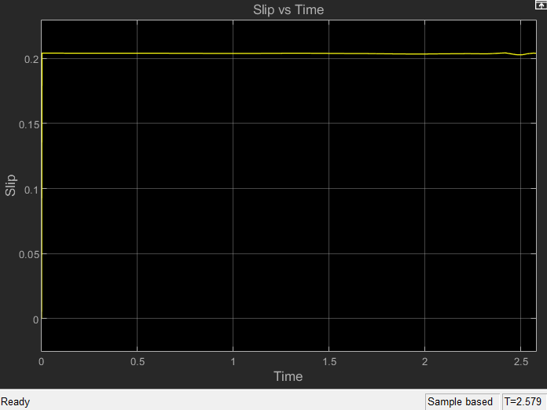
P Controller Results: Slip v/s time
A Steady State Error Exists. Can be Solved with Integrator

Slide 15
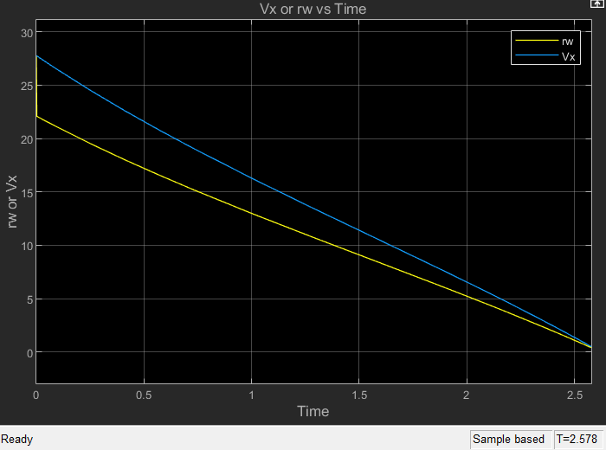
PI Controller: Velocity v/s time
Wheel peripheral velocity and longitudinal velocity become zero almost At same time.

Slide 16
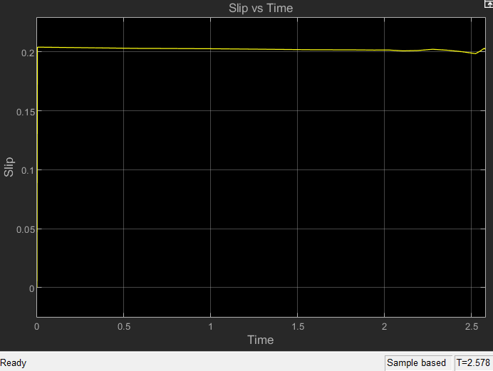
PI Controller: Slip v/s time
A Steady State Error Exists. Which got slightly adjusted at the end. Adding a Derivative controller can reduce oscillations

Slide 17
PD Controller: Velocity v/s time
Wheel peripheral velocity and longitudinal velocity become zero almost at same time.

Slide 18

PD Controller: Slip v/s time

Slide 19

PID Controller: Velocity v/s time
As Usual, Wheel peripheral velocity and longitudinal velocity become zero almost at same time.

Slide 20
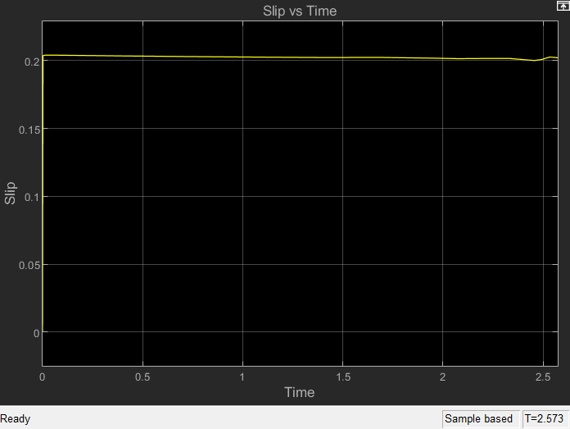
PID Controller: Slip v/s time
The error is almost zero i.e., the actual value of slip is very close to desired value

Slide 21
Observation Table
Controller | Stopping Time | Stopping Distance | Coefficient of Friction
Open Loop | 3.527 | 45.73 | 0.7488
P Controller | 2.579 (-31%) | 35.24 (-26%) | 1.147 (+42%)
PI Controller | 2.578 (-31%) | 35.22 (-26%) | 1.148 (+42%)
PD Controller | 2.576 (-31%) | 35.19 (-26%) | 1.148 (+42%)
PID Controller | 2.573 (-31%) | 35.17 (-26%) | 1.148 (+42%)
• We can nee no significant changes when between P, PI, PD, PID, so to save costs we can go with P controller only..

Slide 22
Conclusion
• It is obvious that ABS improves the braking performance
• The stopping distance after using ABS system has considerably reduced.
• The error in slip and desired slip is used to manipulate brake pressure in brake cylinder.
• Only a linear model was considered and does not include actual road conditions.
• The system here is modelled only for straight line braking.
• In case of cornering, the side slip ratio would be controlled so that wheels don’t lock and thus ensuring steerability.

